Slide 1




Team 1
Bastien Baret
Lou Kramer
Cristoffer Sarevall
Jennifer Tipecska

Slide 2
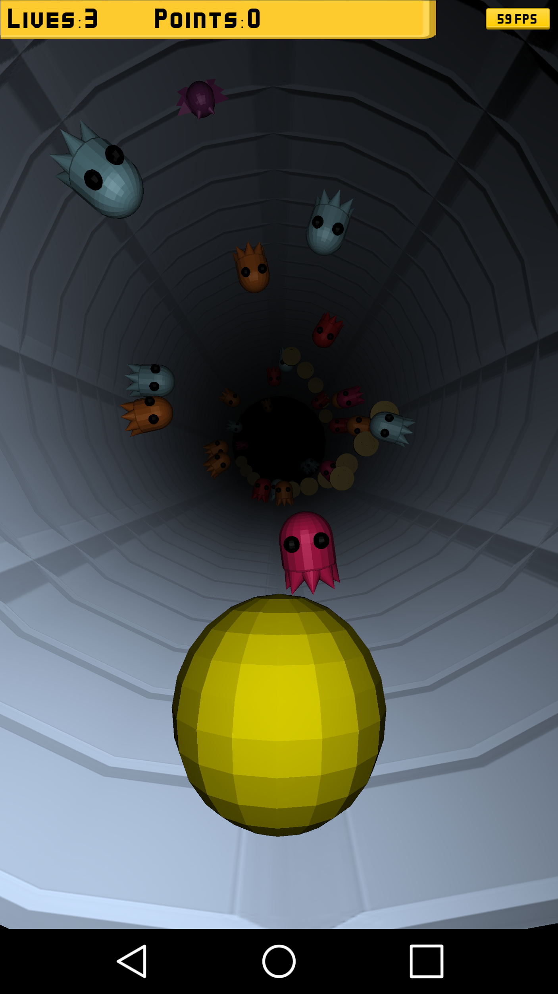

Pacman Tunnel
A dead end! There is only one way out of the tunnel and this is going straight.
But Blinky, Pinky, Inky and Clyde are coming in swarms.
Help Pacman to escape by rotating the tunnel so he can avoid the ghosts.
Be sure to collect coins on your way out to get the best highscore!

Slide 3
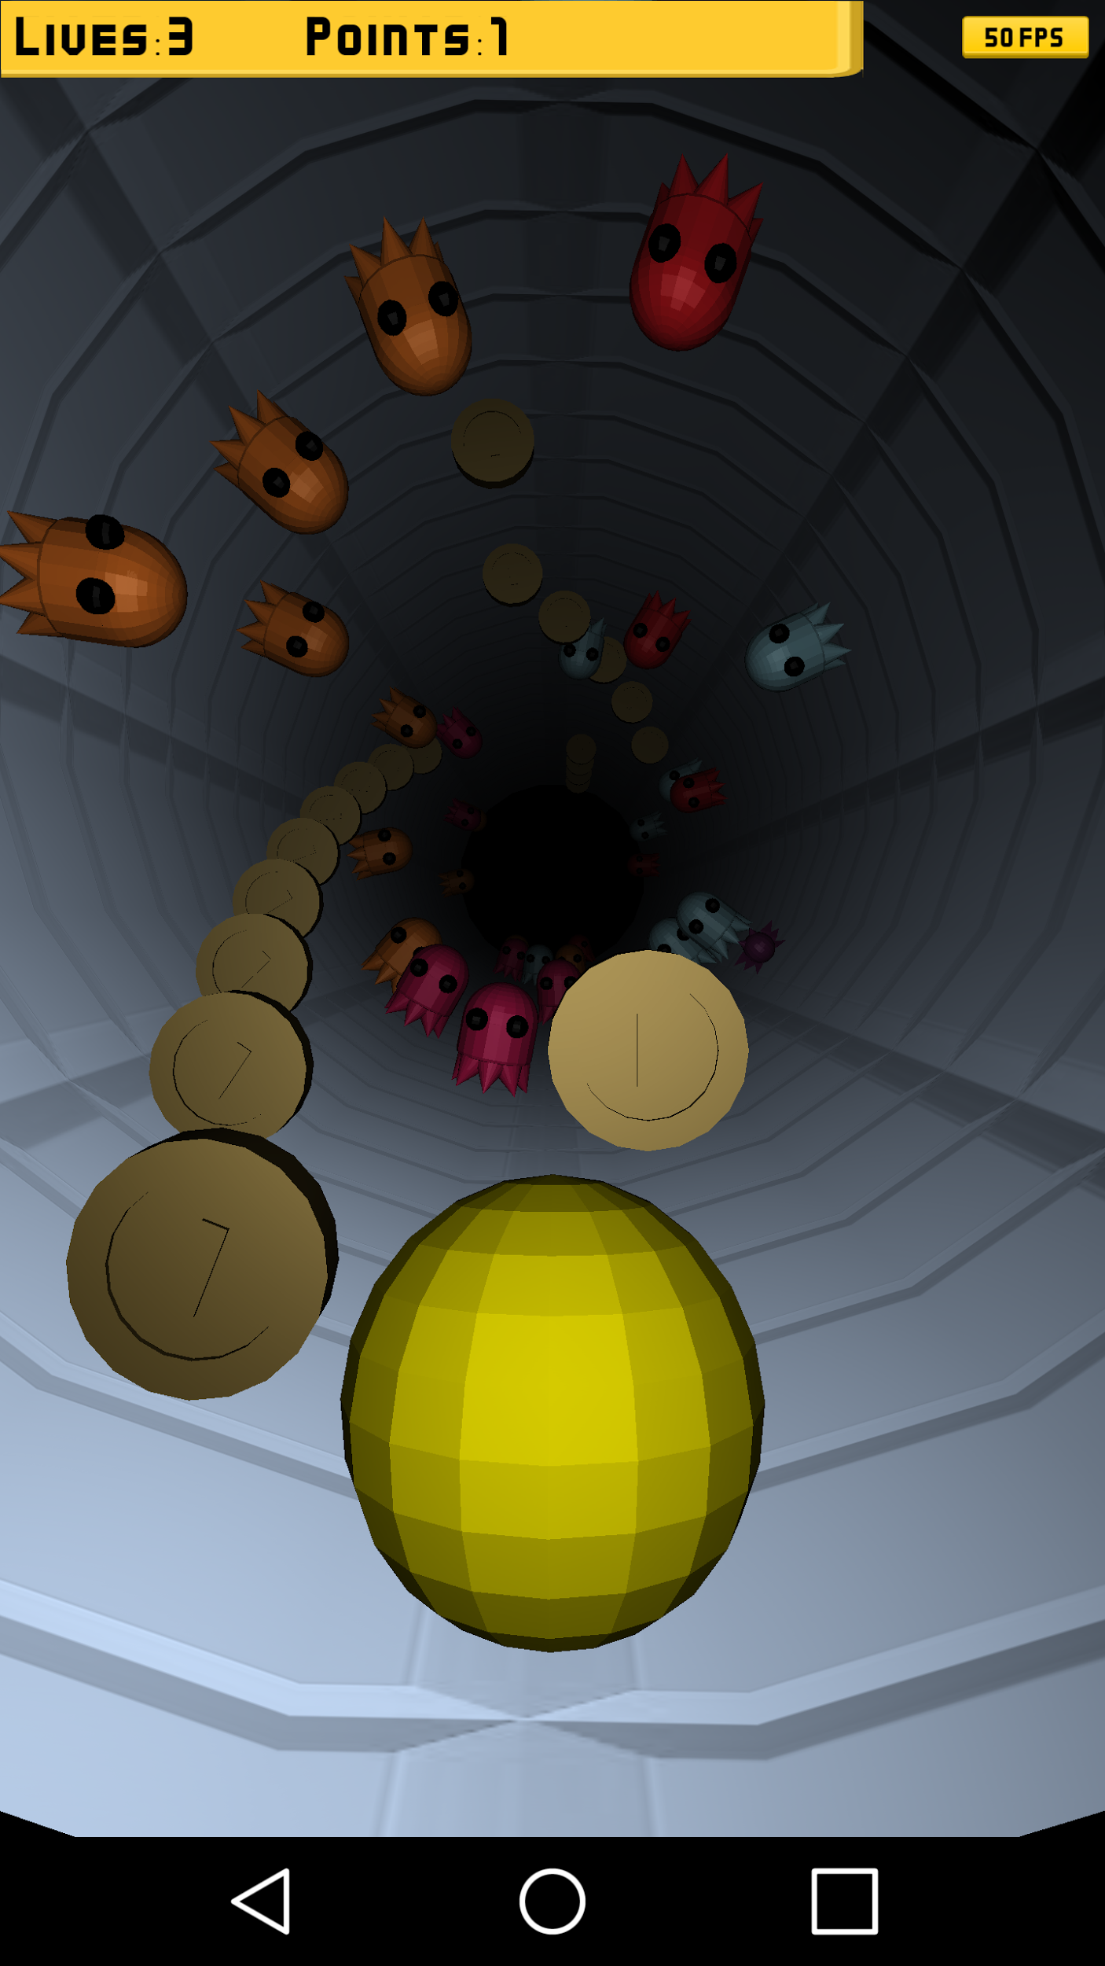
Basic gameplay
Tilt the phone to rotate the tunnel
Once a ghost is hit, you lose one life
Each collected coin grants 1 score point
You have three lives, after all are gone it is Game Over!

Slide 4
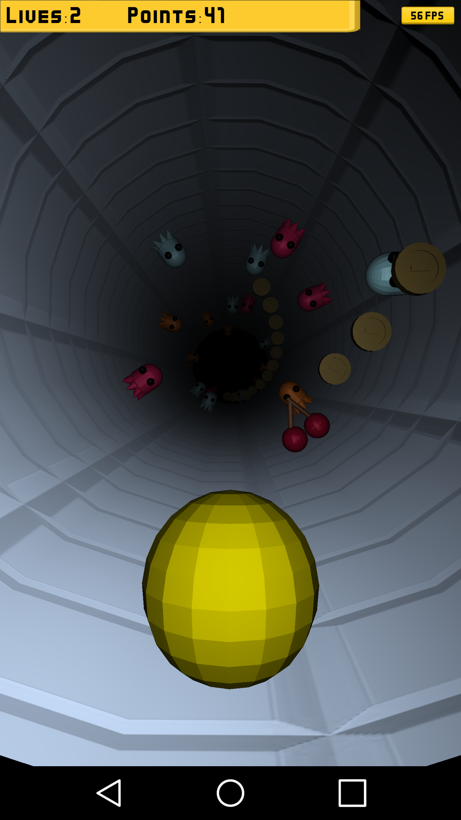
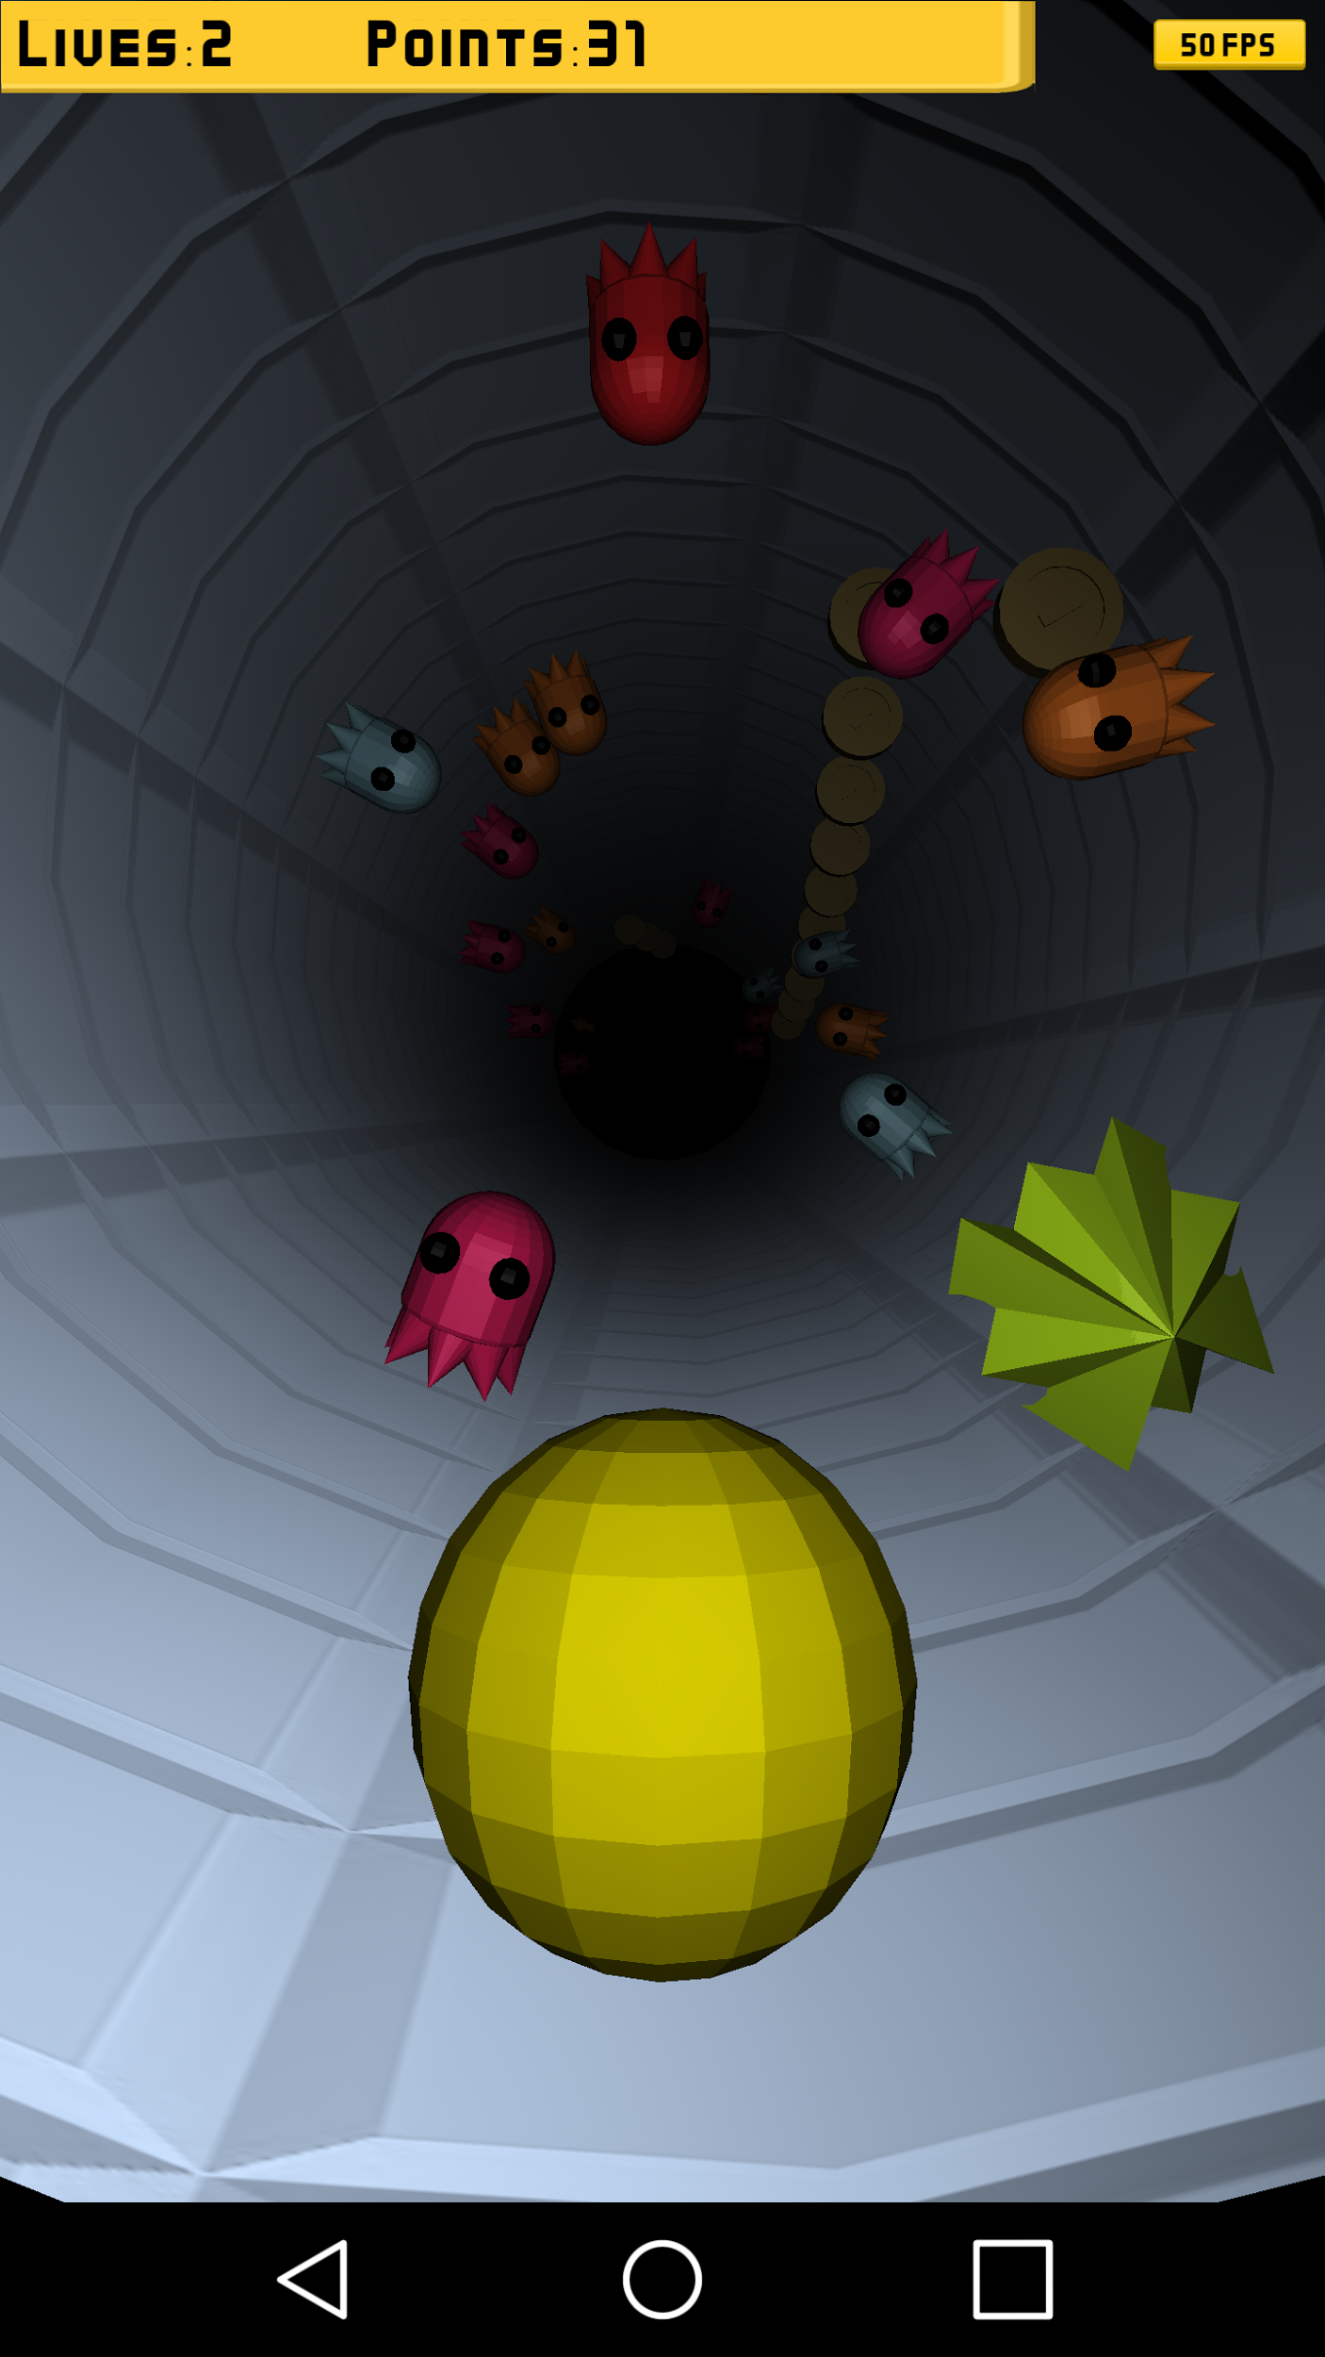
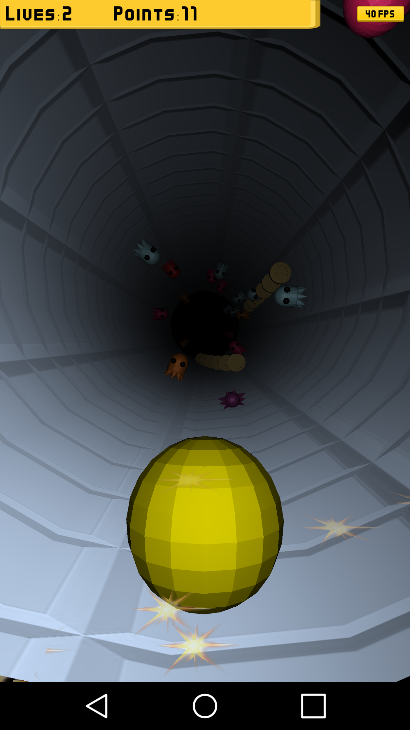
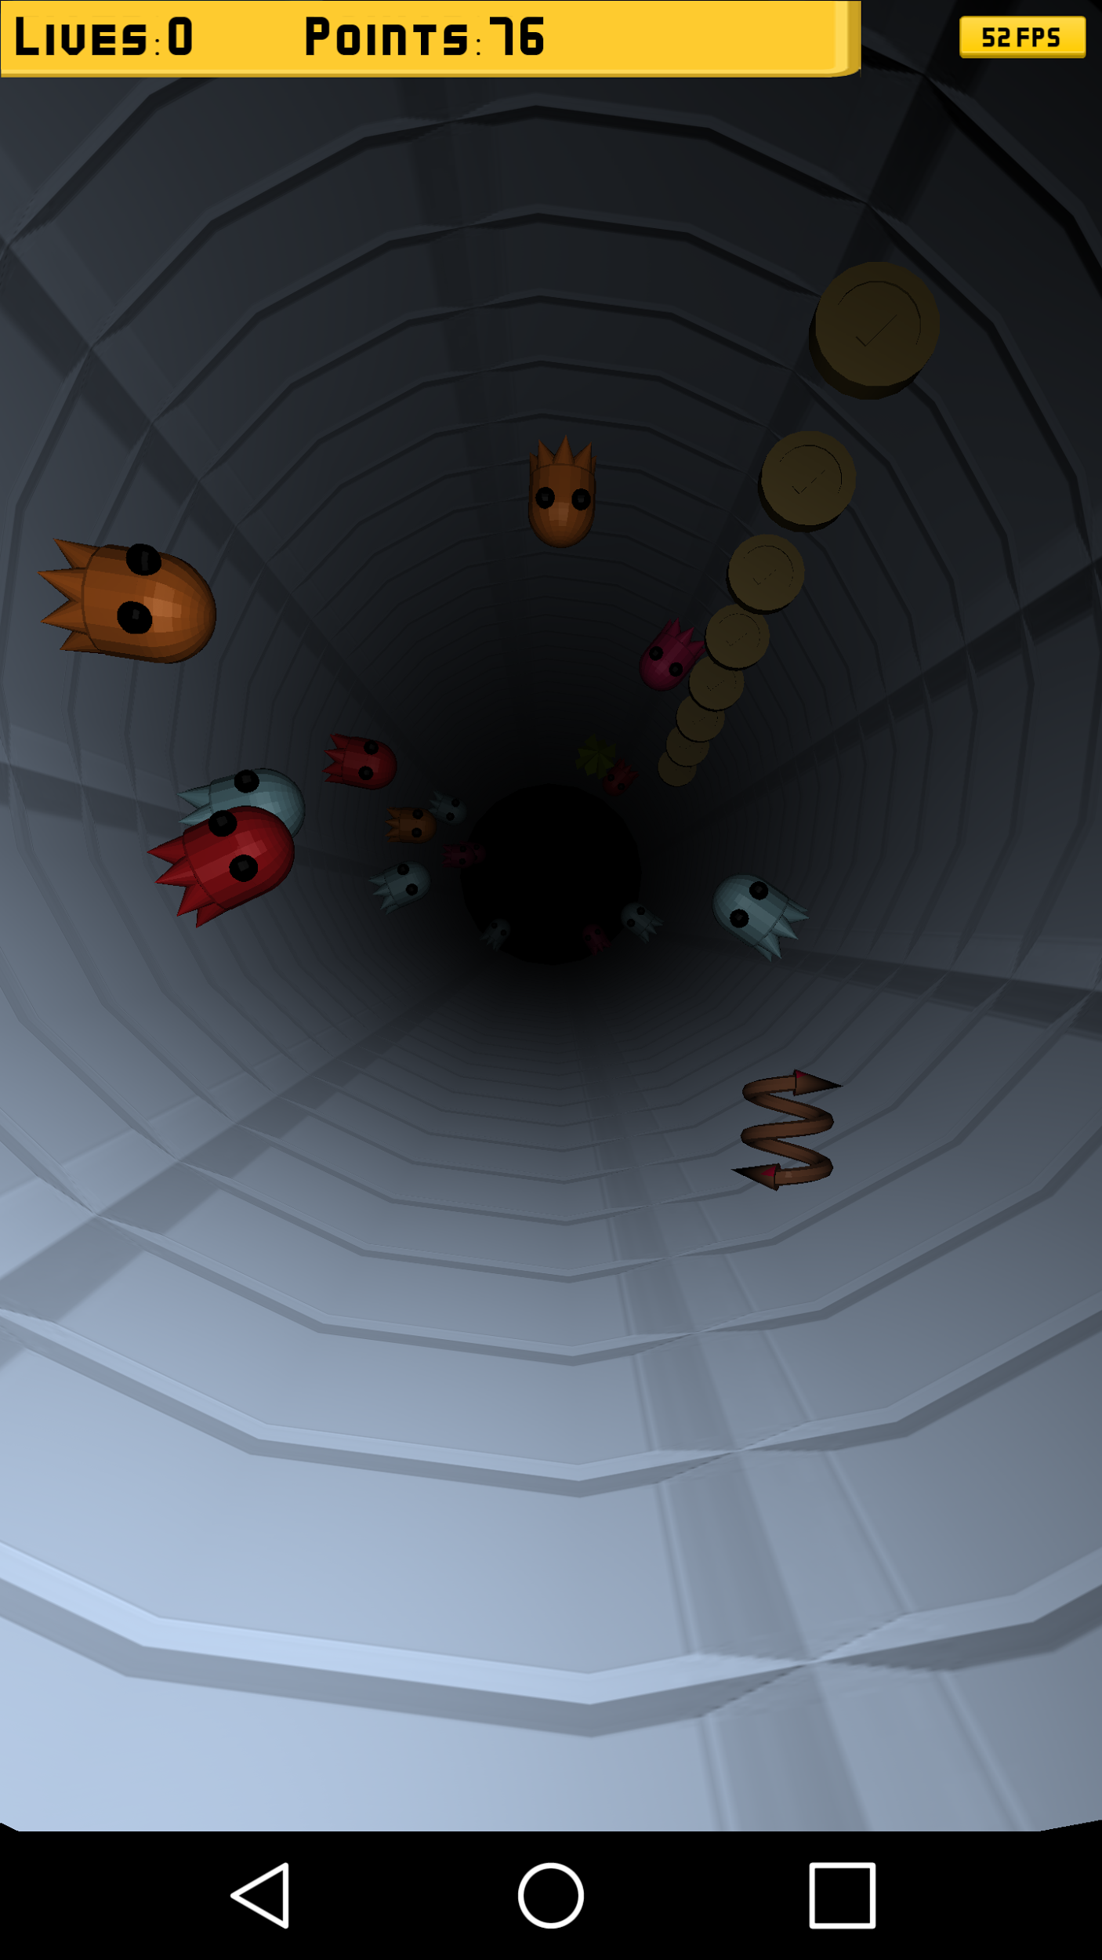
Bonus and malus items
Bonus:
collect the cherries for double points on coin collection
collect the shield for temporal invulnerability
Malus:
avoid the dark malus or the tunnel gets darker
avoid the reverse malus or your tilt input gets reversed

Slide 5
User Study
12 Participants were asked to play the game for a short amount of time
Each Participant was asked to fill out the User Study
Consists of 5 question with a scale from -- to ++
Consists of 3 free form question, were individual feedback was asked

Slide 6
User Study
How was the game difficulty when you first started playing? (hard -> easy)
(--) (-) (-+) (+) (++)
25% 0% 17% 33% 25%

Slide 7
User Study
Would the Game entertain you over a longer Period of time? (short -> long)
(--) (-) (-+) (+) (++)
18% 27% 18% 37% 0%
In Relation to 11 People, one Participant did not answer

Slide 8
User Study
What did you think about the difficulty of the user input? (difficult -> simple)
(--) (-) (-+) (+) (++)
0% 8% 8% 25% 59%

Slide 9
User Study
How did you like the number of the additional Bonus/Malus items?
(--) (-) (-+) (+) (++)
0% 0% 42% 42% 16%

Slide 10
User Study
Were the animations for the Bonus/Malus items easy to understand?
(--) (-) (-+) (+) (++)
9% 18% 9% 27% 37%
In Relation to 11 People, one Participant did not answer

Slide 11
User Study
The following feature would improve the game greatly:
More Animations (Ghost movement, animation for disappearing bonus)
Sound Animation
Instant Retry Button
Better calibration of the Accelerometer

Slide 12
User Study
The level of difficulty could be increased through:
Level Design
Speed increase over Time
Change in Tube Layout
Better Enemy AI and Distribution

Slide 13
User Study
The overall game is in need of:
Different Enemies Types (and their Effects)
Tutorial before beginning
Gaining back lifes
More overall lighting

Slide 14
Game Testing
You can download the game at: http://bit.ly/2gBukCt

